Slide 1
Introduction to Machine Learning
Machine learning concepts
Classification
Clustering

Slide 2
Section 1: Machine Learning Concepts
What is machine learning?
Machine learning usage scenarios
Supervised learning
Unsupervised learning

Slide 3
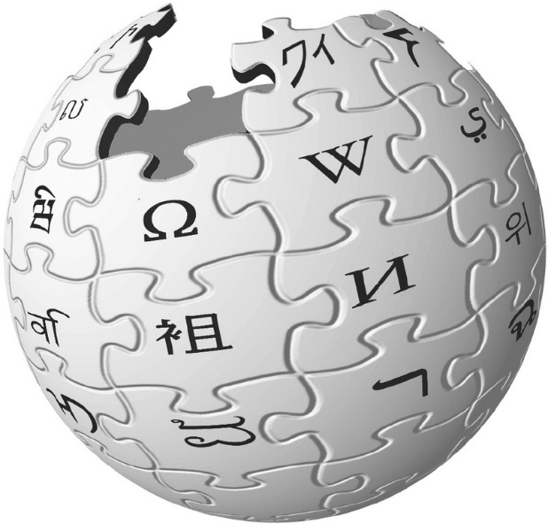
What is Machine Learning?
According to Wiki:
Machine learning is a field of computer science that uses statistical techniques to give computer systems the ability to "learn" (e.g. progressively improve performance on a specific task) with data, without being explicitly programmed.
Evolved from the study of pattern recognition and computational learning theory in artificial intelligence, machine learning explores the study and construction of algorithms that can learn from and make predictions on data – such algorithms overcome following strictly static program instructions by making data-driven predictions or decisions, through building a model from sample inputs.

Slide 4
Machine Learning Usage Scenarios
Machine learning is all about building a mathematical model that helps you understand data
Example scenarios:
Email filtering (spam or not-spam)
Forecasting (e.g. stock market trends)
Spotting outliers (rogue datapoints)
Product recommendations
There are two categories of machine learning:
Supervised learning
Unsupervised learning

Slide 5
Supervised Learning
What is supervised learning?
You start with labelled training data, which allows you to create a model that describes relationships between input/result data
You can then apply the model for test data, to predict results
Classification is an example of supervised learning
Uses training data to determine how new data should be labelled into existing distinct categories
Regression is another example
Similar to classification, except new data is labelled into continuous categories (rather than distinct categories)

Slide 6
Unsupervised Learning
What is unsupervised learning?
With unsupervised data, you start with unlabelled training data
You don't know how to label the data up-front
Clustering is an example of unsupervised learning
Takes an unlabelled dataset and identifies patterns and trends
Clusters similar input into logical groups
Dimensionality reduction is another example
Reduces the number of random variables under investigation, by obtaining a set of principal variables
The motivation is because data analysis can be done more accurately if noise is eliminated

Slide 7
Section 2: Classification
Overview
Scenario
The challenge
Fitting a model to the data
Using the model to label (classify) future results
Classification in the real world
Aside: Classification with continuous labels

Slide 8
Overview
In this section we'll show a hypothetical example that will help you understand how classification works
Recall, classification is an example of supervised learning
You start off with some labelled training data
You fit a model to the training data
You can then use the model to classify (predict) future outcomes

Slide 9
Scenario
The following diagram plots 2-dimensional data (i.e. the data contains two features)
E.g. feature 1 is a person's age, feature 2 their academic score
The colour of the dot is an observed label, e.g. how did the person vote in a referendum
feature 2
feature 1

Slide 10
The Challenge
Based on the observed training data, here's the challenge:
How can you predict how other people will vote?
i.e. if you measure feature 1 and feature 2 for another person, how can you predict how to label that person (orange or blue)?
feature 2
feature 1

Slide 11
Fitting a Model to the Data
There are several ways you can create a model based on this data, and then fit the model to the training data
A simple model would be to assume you can draw a straight line that separates the two categories
To fit the model to the data, just decide where to draw the line
feature 2
feature 1

Slide 12
Using the Model to Label (Classify) Future Results
Based on where you've chosen to draw the line:
The model predicts that the new datapoint should be labelled as an orange dot
feature 2
feature 1

Slide 13
Classification in the Real World
The example we just discussed is simple and obvious
We could have just guessed the outcome, because the data is so clearly segregated
In the real world, data is much more complicated
Thousands/millions of features (e.g. dubious words in emails)
Based on the counts of such words, we could produce a model that labels future emails as spam or not spam
There are several standard classification models available
Naïve Bayes
Support Vector Machines

Slide 14
Aside: Classification with Continuous Labels
What if you have a continuous label, e.g. life expectancy?
How do you classify (predict) new datapoints?
One approach would be to treat the continuous label as another dimension, then try to find a plane that contains the points
For new datapoints, you can then predict its position on the plane
feature 2
feature 1

Slide 15
Section 3: Clustering
Overview
Scenario
The challenge
Fitting a model to the data
The k-means clustering algorithm

Slide 16
Overview
In this section we'll show a hypothetical example that will help you understand how clustering works
Recall, clustering is an example of unsupervised learning
You don't start off with unlabelled training data
You build a model that describes data by discovering relationships and trends

Slide 17
Scenario
The following diagram plots 2-dimensional data (i.e. the data contains two features)
Note that the dots are uncoloured (i.e. the data is unlabelled)
feature 2
feature 1

Slide 18
The Challenge
Based on this data, here's the challenge:
How can you model the clustering?
i.e. how can you define discrete groups, and then decide which group a particular datapoint belongs to?
feature 2
feature 1

Slide 19
Fitting a Model to the Data
There are many clustering algorithms available in ML
E.g. k-means clustering
This identifies k cluster centres, by minimising the distance between a cluster centre and the datapoints in that cluster
Our example would suggest the following clustering:
feature 2
feature 1

Slide 20
The K-Means Clustering Algorithm
Choose the number of clusters (k)
Randomly select k points, to act as the initial centroids
Calculate distance between each data point and each centroid
Assign each data point to the closest centroid
Calculate mean of all data points and each centroid, and update centroid's position
Repeat steps 4/5 until algorithm converges (i.e., centroids stop moving significantly)
feature 2
feature 1

Slide 21
Summary
Machine learning concepts
Classification
Clustering

